Slide 1
Where to find your customers’ Subscription codes?
Christopher Crane Data and AI CSM August 2019

Slide 2
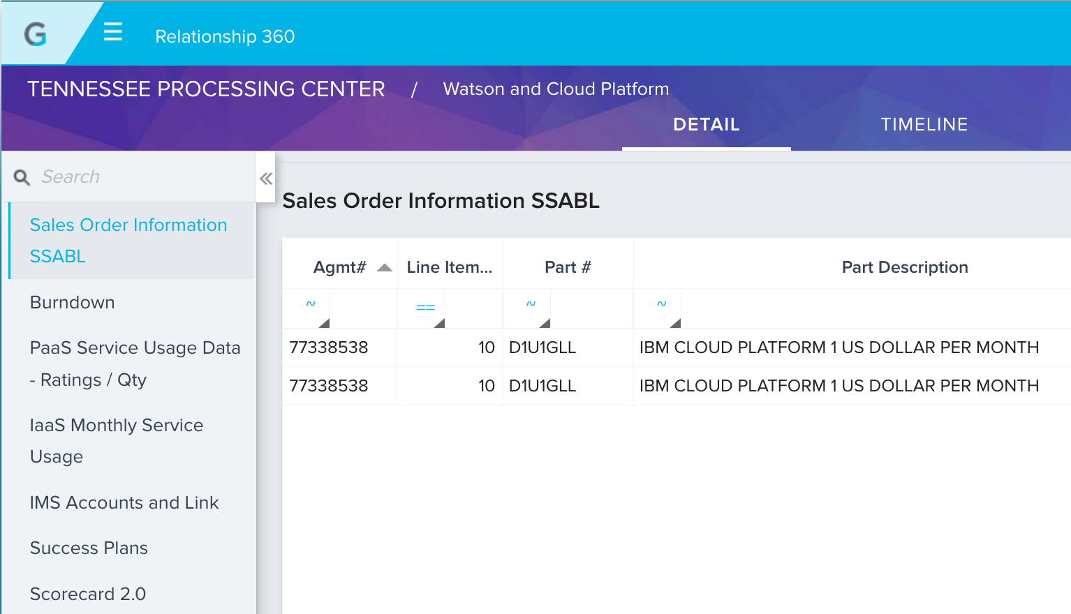
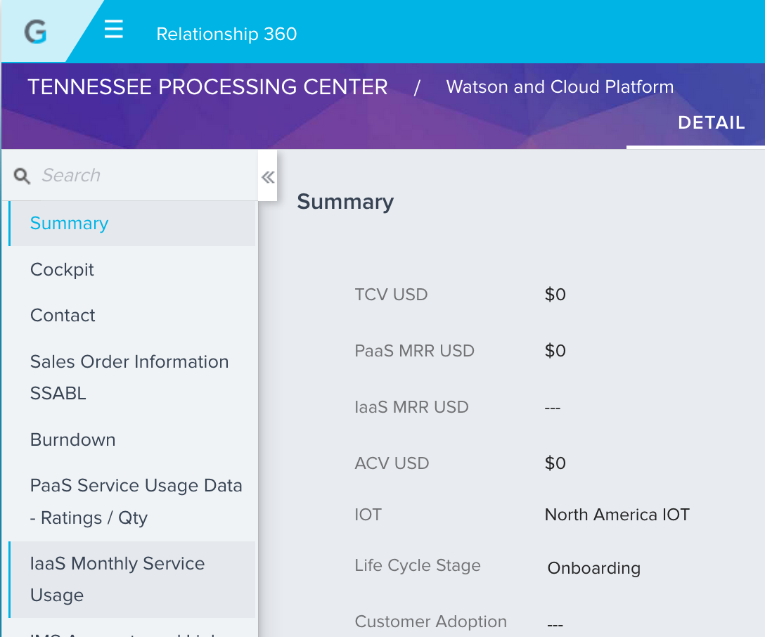
Obtain the Cloud Agreement number
You can find it in Gainsight under the Sales Order Information Tab in your client’s Watson and Cloud Platform R360.
Confirm the agreement number aligns with the correct part number and description.
2.
1.

Slide 3
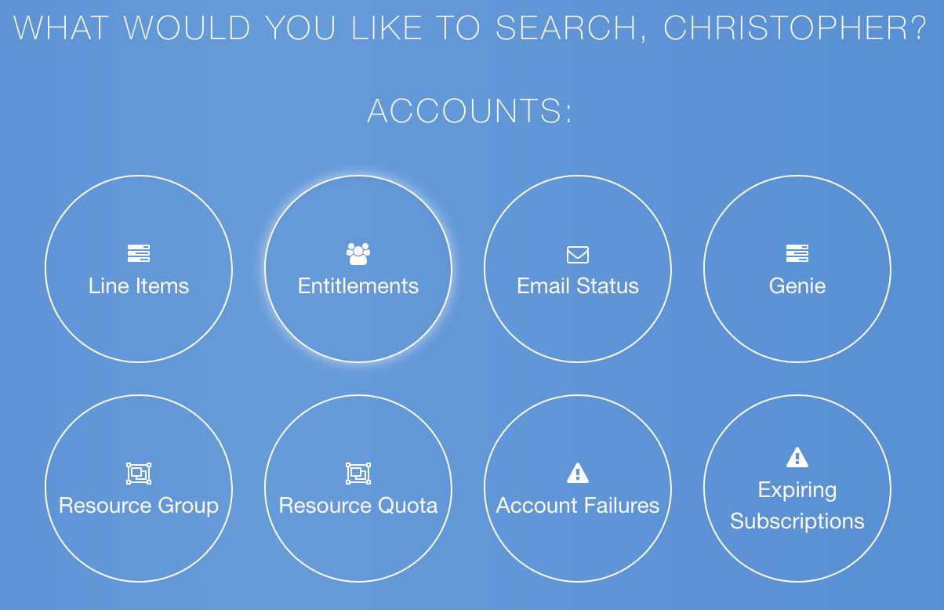
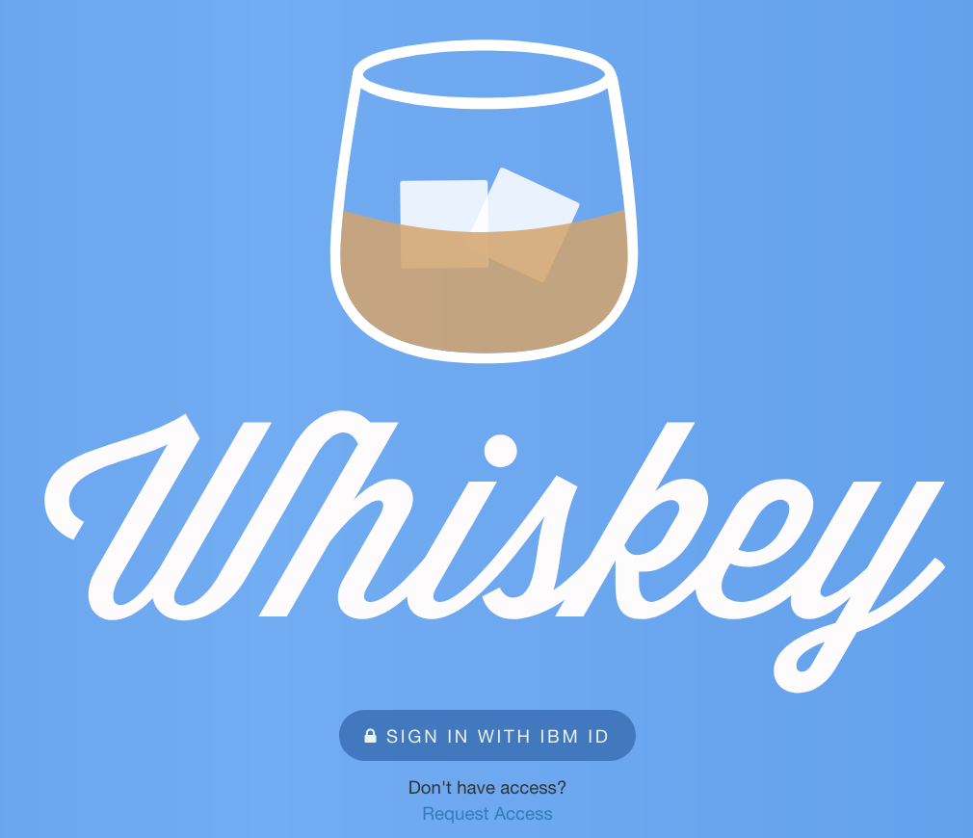
Go to Whiskey
Whiskey is the systems used to display BSS data. It can be found here: https://bsswhiskey.stage1.bluemix.net/signin. If you don’t have access you can request it via the link below the login. Access is not guaranteed.
2. Once logged in scroll to the search selection and choose “Line Items”
2.
1.

Slide 4
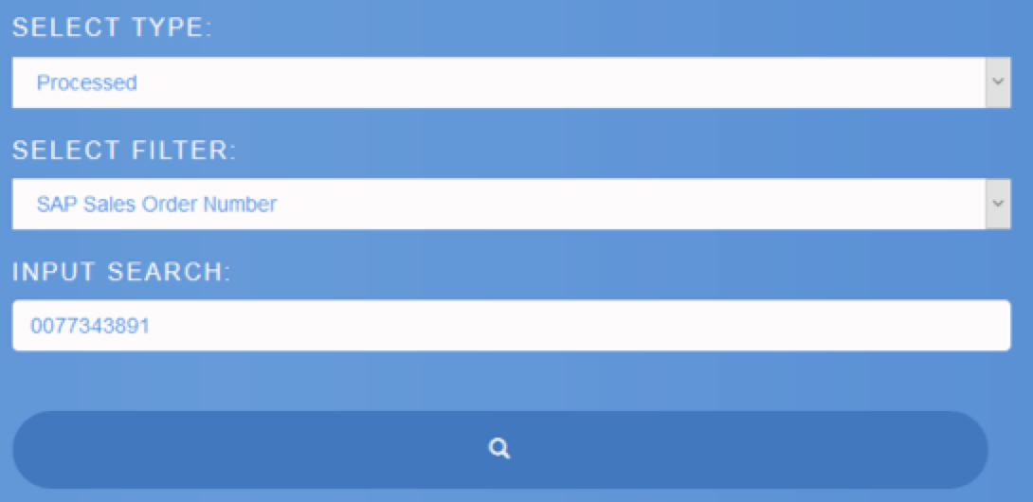
Search Whiskey
Scroll down,
Select Type = Processed
Select Filter = SAP Sales Order Number
Input Search =The Charge Agreement number (Must have its 2 leading zero’s)
Click the search button
.
.

Slide 5
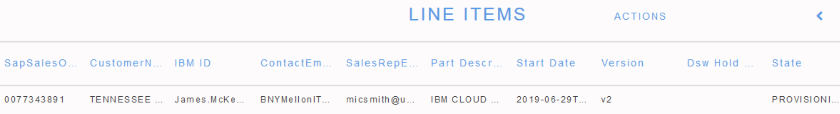
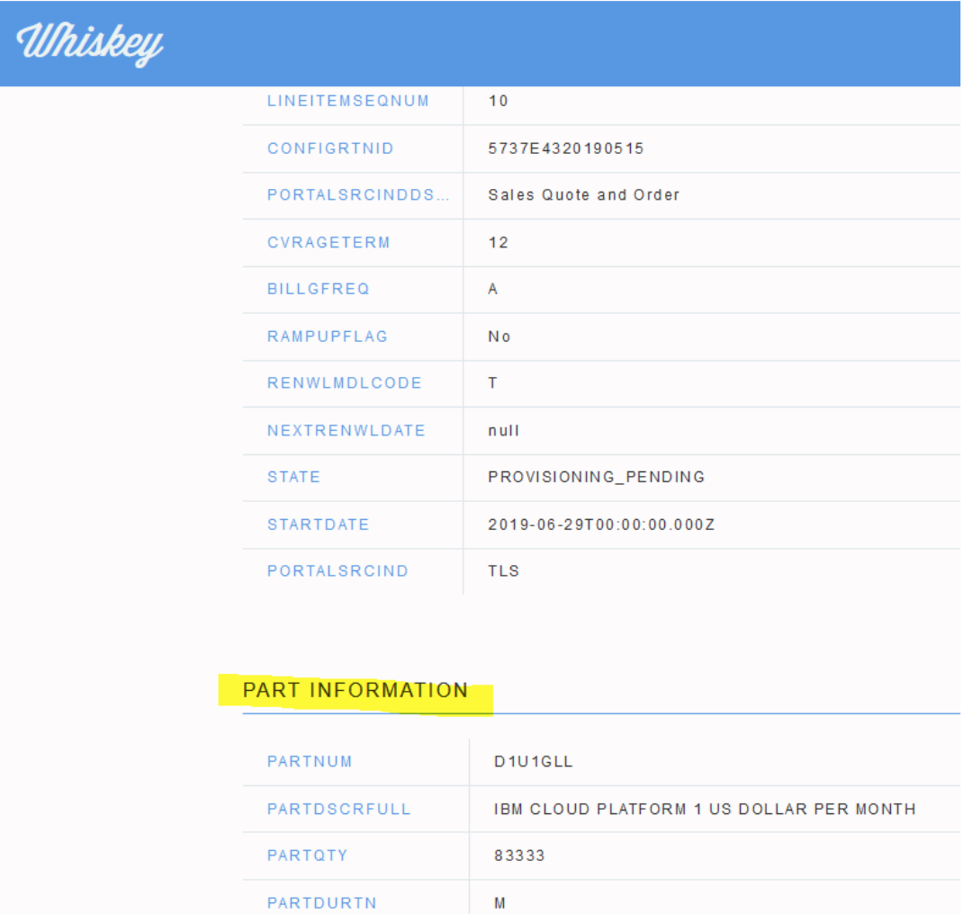
Open the Whiskey entry
Hover over the entry and it will turn grey. Click it and enter.
Look in the section entitled “Part Information”. Look for the SAAS Subscription part and make sure it corresponds with what you intent to provision. It could be a Watson or Native Bundle Part, Cloud Platform, subscription or Pay per Use part
.
.

Slide 6
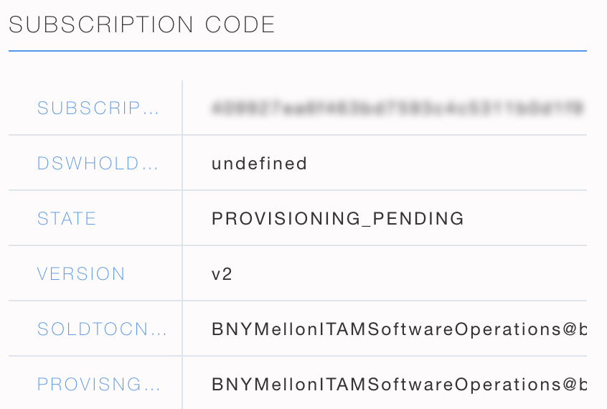
Find the Subscription Code!
Scroll down to the SUBSCRIPTION CODE section on the right side of the screen. This will give you:
The subscription code and…
Where it was emailed, as well as…
The status of the Provisioning.
If the code has not been entered yet by the customer it should say “PROVISIONING_PENDING”.
If the status is anything other than Provisioning Pending such as “Completed” or “Hold Removal Requested”, then there will be a Line Item Hold Status, however the Provisioning Pending status will always be shown until the subscription code has been applied & then only the Line Item Hold status will show.
.

